Slide 1


Bad Loan Predictor
Alex Carter
Carl Adams
Evelyne Benie
Jeff Olson
Keisha McCallum
Messac CN
Notes:
Keisha

Slide 2

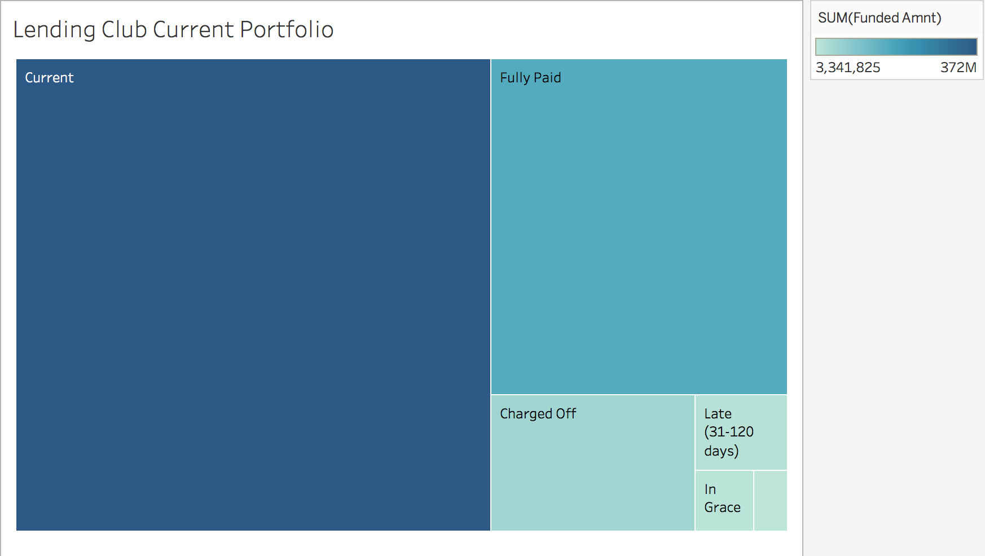
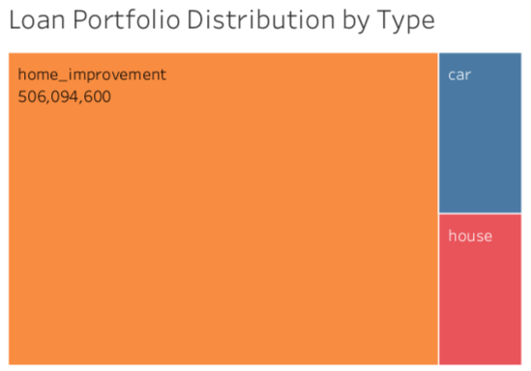

Background
Problem Identification
Lenders face challenges deciding which loans are more likely to become delinquent or charged off
A tool that predicts which loans will go bad can minimize lenders risk and improve their bottom line.
Problem Definition
Focus on secured loans.
Car, house, home improvement
Data Source
2017 Data
Notes:
Carl

Slide 3


Bad Loan Predictor
Project Schedule and Time Line
Status:
100% Requirements
0% In progress
100% On time Delivery
No Obstacles
Form project team
Brainstorm ideas, select topic
Prepare and submit project proposal
Understand data and limitations
Outline data analysis strategy
Performed required data transformations and clean ups
Experiment with multiple models
Select the most optimal model
Plan for evaluation and improvement
Project Deployment
Final reports, dashboards and presentation
Start
Identify and Define Problem
Data Exploration and Pre-Analysis
Model Fitting, Reduction and Prediction
Launch and Closeout
2
4
6
Align to Machine Learning Problem
Data Cleaning and munging
Beta Test and Optimize
1
5
7
3
Tailor problem to data science problem
Strategize on machine learning problem category
Perform exploratory and visual analysis
Identify prediction and target features
Narrow down and select modelling techniques
Testing and optimizing predictive model
Front-end app for deployment
100% Complete
Notes:
Messac

Slide 4
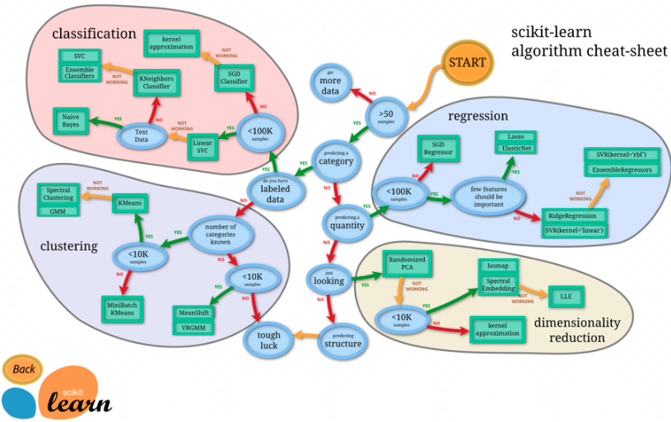
Map Problem to Machine Learning Problem
Supervised Learning Model
145 Data Elements
Two Years (2017 and 2018)
Over 5M Data Points
Test Several Models
40K+ Records
Notes:
Jeff

Slide 5
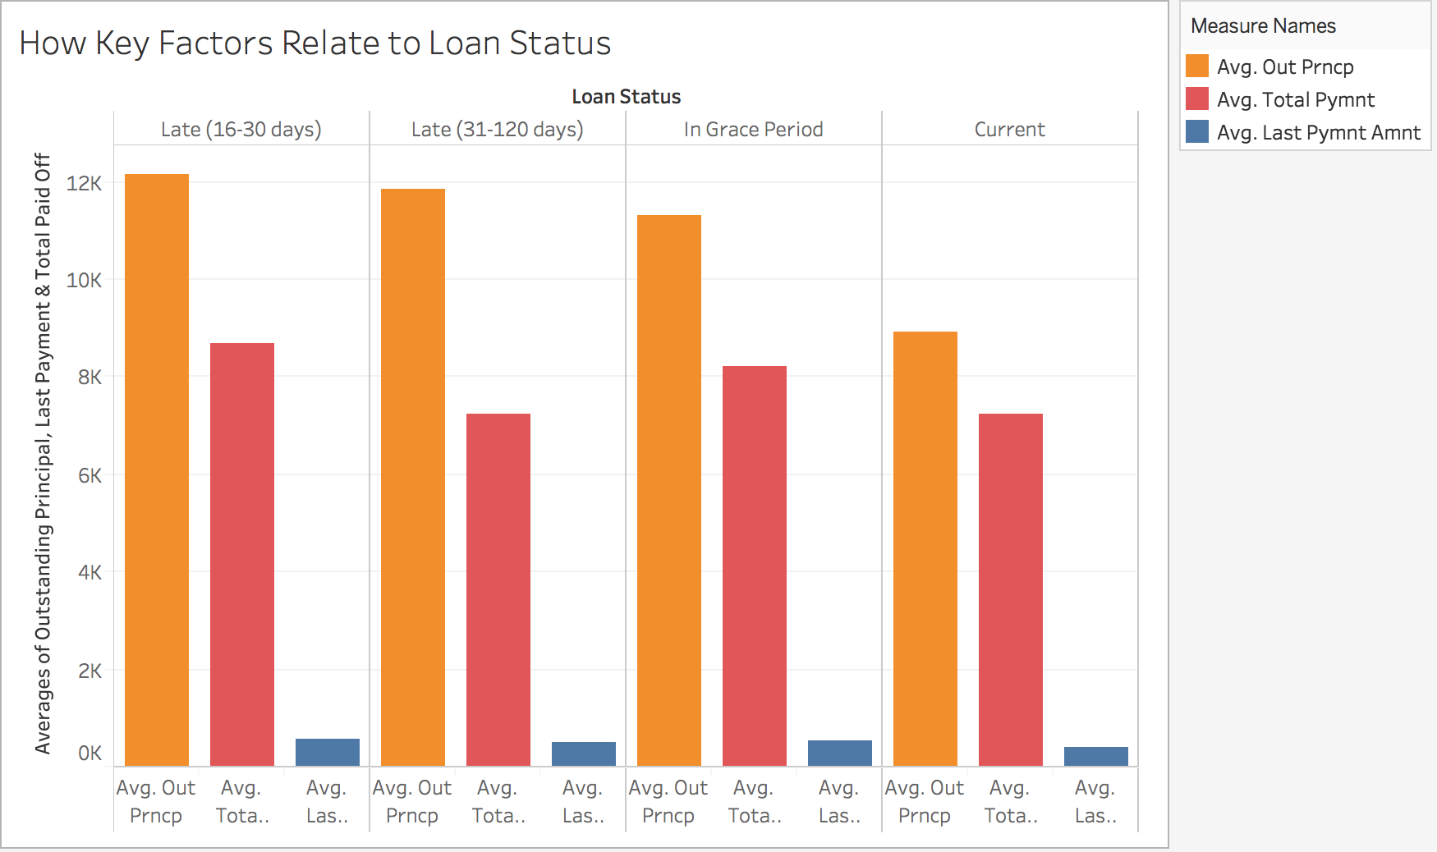
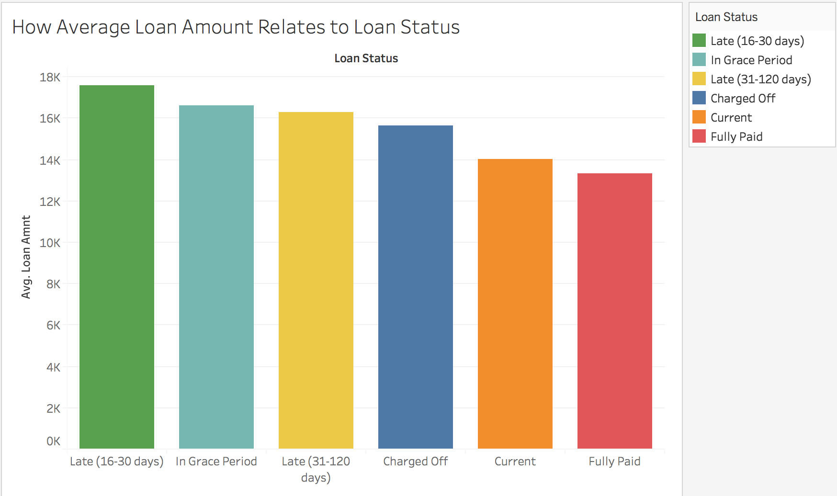
Data Exploration and Pre-Analysis
Tableau
Notes:
Carl

Slide 6
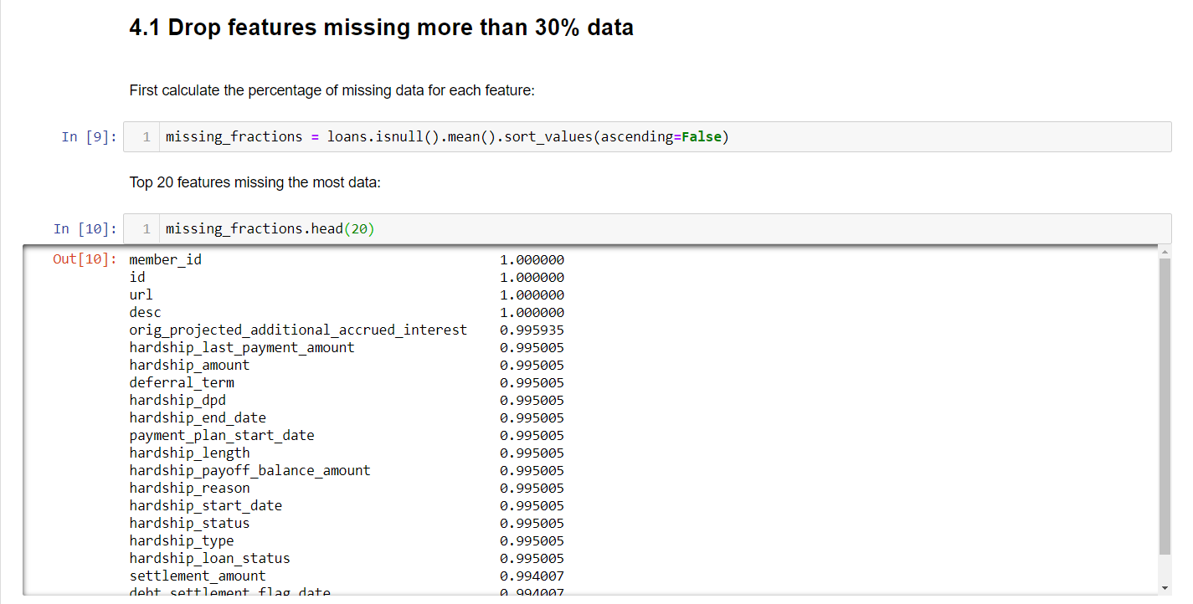
Data Cleaning & Munging
Notes:
Evelyne

Slide 7
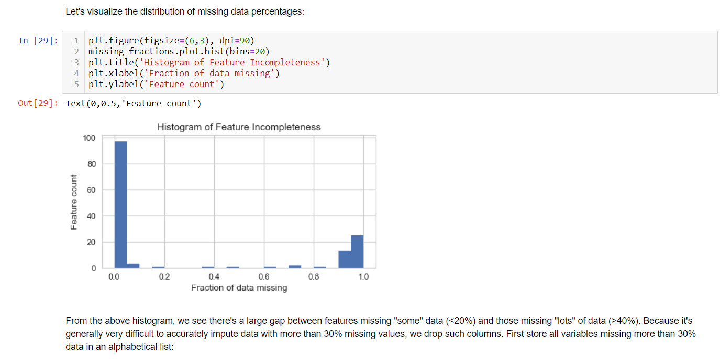
Data Cleaning & Munging Continues …
Notes:
Evelyne

Slide 8
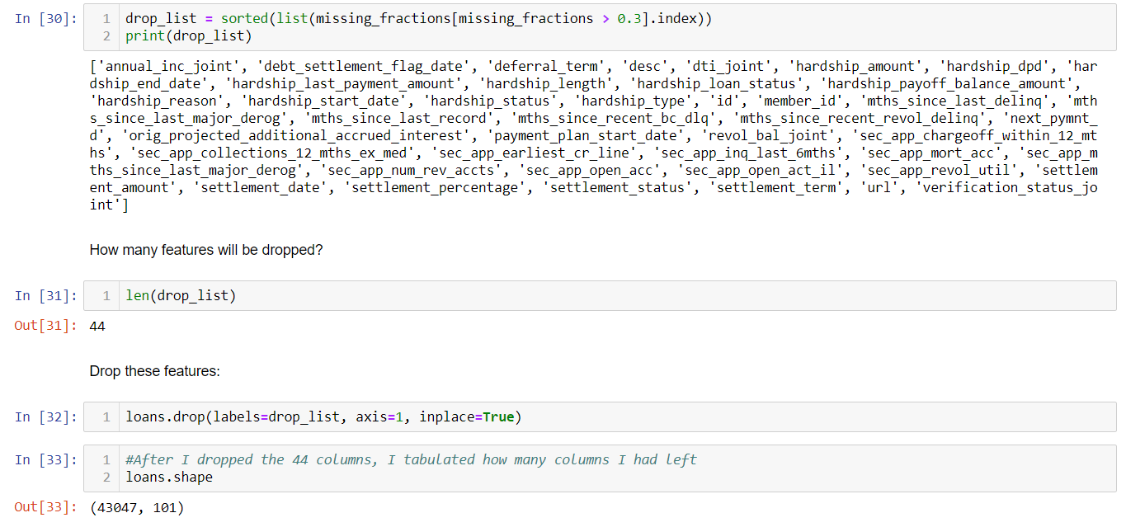
Data Cleaning & Munging Continues …
Notes:
Evelyne

Slide 9
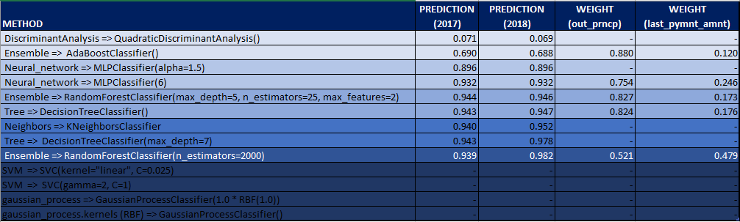
Algorithms Evaluation and Selection
Notes:
Jeff

Slide 10
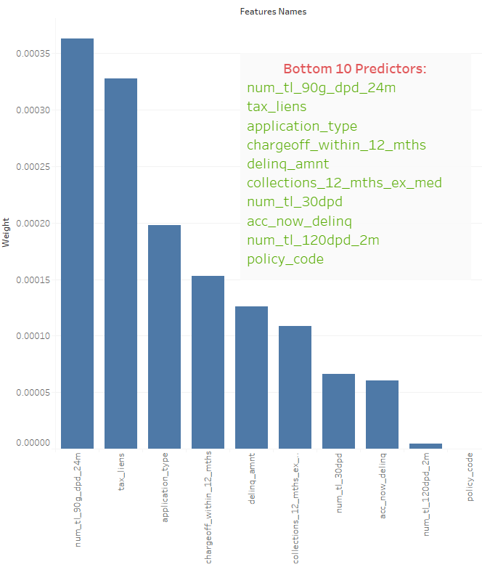
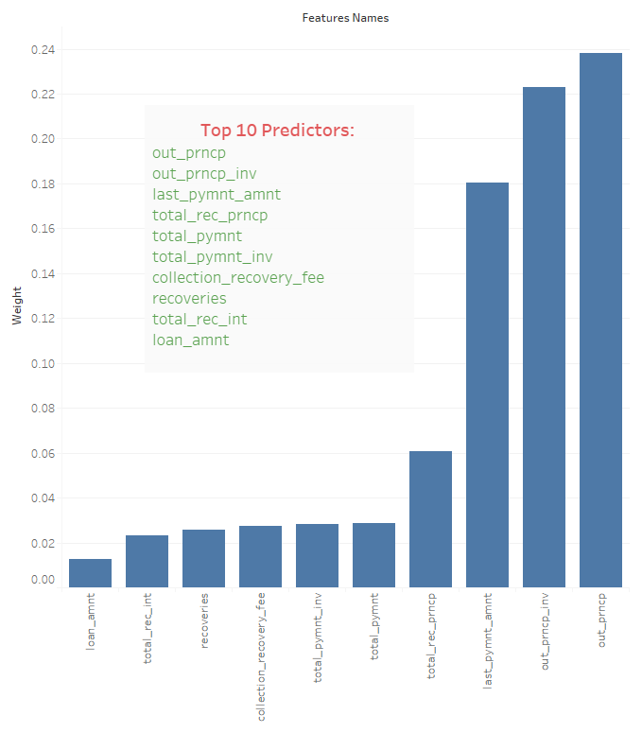
Features Reduction & Selection
Notes:
Evelyne

Slide 11
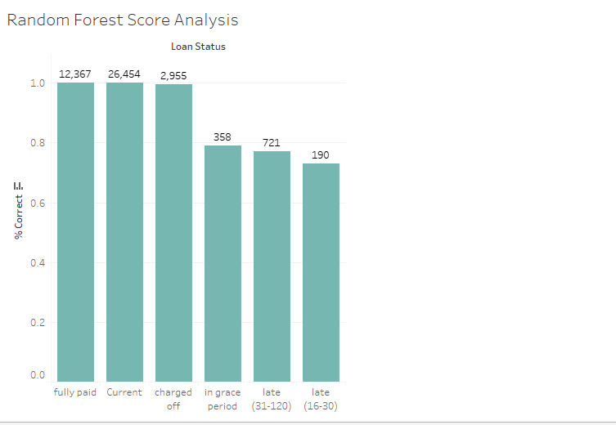
Machine Learning Model Fitting and Predictions
Model Fitting
Model Prediction
Beta Testing and Improvements
Notes:
Alex

Slide 12
Lessons Learned
Review Project Requirements
Highlight Deliverables
Discuss Lessons learned
Acknowledgements
Current Portfolio
Notes:
Keisha

Slide 13
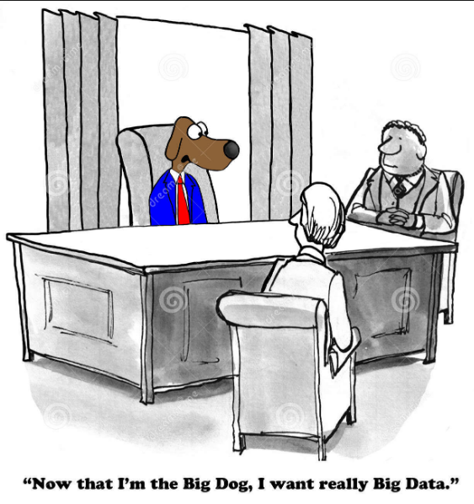
Thank You!
Q & A

